Slide 1

Chapter 7
Memory

Slide 2
Applications of Memory Research
How can you improve your memory?

Slide 3
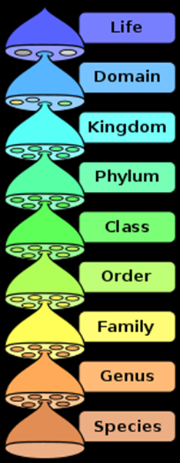
Mnemonic Strategies
Organize information
  Method of loci
    Associate images of information with places you know
  Acronyms
    HOMES (Huron, Ontario, Michigan, Erie, Superior)
  Acrostics
    King Philip came over for great spaghetti
    (kingdom, phylum, class, order, family, genus, species)
  Rhyming
    I before E, except after C,
    or when sounded as “a”,
    as in neighbor and weigh

Slide 4
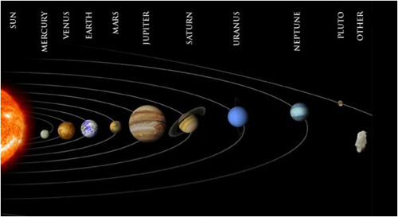
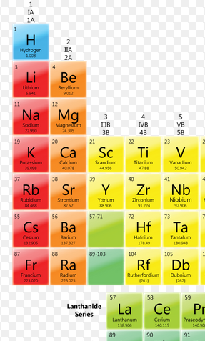
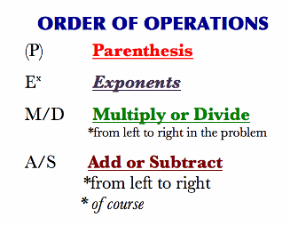
Highly Nasty Kids Rub Cats Fur
Most Volcanoes Erupt Mulberry Jam Sandwiches Under Normal Pressures
Washington, Adams, Jefferson, Madison, Monroe, (Quincy) Adams, Jackson, Van Buren. Harrison, Tyler, Polk, Taylor, Filmore, Pierce, Buchanan, Lincoln.
Please excuse my dear aunt Sally.
Will A Jolly Man Make A Jolly Visitor. How Truly Poor That First Paper Boy Looks

Slide 5
Study More Effectively
Elaborative rehearsal: Relate new information to current knowledge
  Give new information context with an outline
  Don’t just passively read and reread the material
  Maintenance rehearsal alone tends to be ineffective
Use distributed practice, not massed practice
  Cramming doesn’t work – remember Ebbinghaus!
Self-reference effect: make the materials personally meaningful to you.

